Slide 1
TEMPDB CONTENTION HOW TO IDENTIFY AND RESOLVE IT
Haripriya Naidu
SQL DBA
She/Her

Slide 2

About me
SQL Database Administrator – 10 years
Focus on
SQL Server Engine Internals
Performance Tuning
Server/DB Operations
Actively participate in
NESQL
SQL Saturday Boston
Multiple online learning communities
AWS Certified Solutions Architect
Rookie of the Year 2023 @Work

Slide 3
Agenda
Uses of TempDB
Types of Contention
Identifying Contention
Ways to Resolve

Slide 4
Why learn about TempDB Contention
Troubleshoot Slowness
Concurrency Management

Slide 5
What runs on TempDB
User Objects
Version Stores
Internal Objects

Slide 6
User objects
Local and Global Temp Tables - #table, ##table
Local and Global Temp Stored Procedures - #proc, ##proc
Table Variables - @table
Appear in sys.all_objects view

Slide 7
Internal objects
Worktables to store intermediate results for
Sorts, Hash Joins, Aggregates
Spools, Cursors
INSTEAD OF triggers
Store Service Broker messages in transit
Online Index Rebuild when SORT_IN_TEMPDB is ON
Users cannot create these internal objects

Slide 8
Version Stores
Used for Row versioning for the following:
Snapshot isolation levels
Online index operations
AFTER triggers
MARS(Multiple active result sets)

Slide 9
Types of Contention
Object Allocation Contention – DML
Metadata Contention – DDL
Temp Table Cache Contention

Slide 10
Object Allocation Contention - DML
In any database, when there are insert, update, delete operations on user objects, they need a latch (lightweight lock) on PFS, GAM, SGAM pages on a datafile.
In tempdb, there are numerous insert, update, delete operations running concurrently on temporary objects, waiting for a latch on PFS, GAM, SGAM pages on a datafile, causing contention

Slide 11
Datafile – tempdb.mdf
Page 0: File Header
Page 1: Page Free Space (PFS)
Page 2: Global Allocation Map (GAM)
Page 3: Shared Global Allocation Map (SGAM)
Page 4: Unused
Page 5: Unused
Page 6: Differential Change Map (DCM)
Page 7: Bulk Change Map (BCM)
Data pages
… <more data pages>
Tracking pages
Track the status of data pages
Used when SQL Server needs to allocate space
Data pages

Slide 12
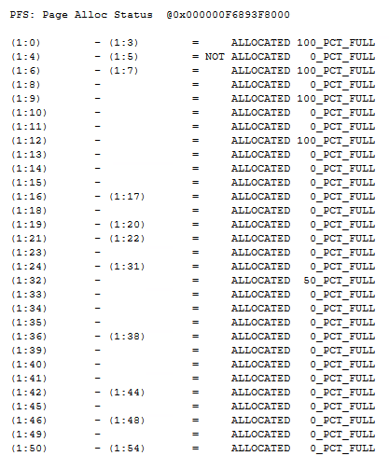
Page Free Space (PFS)
Page 1: PFS
Tracks free space available for each page
All operations need a latch on PFS page to know which page has space

Slide 13
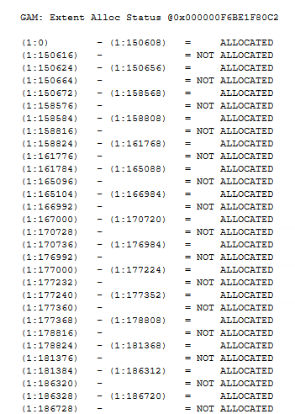
GAM (Global Allocation Map)
Page 2: GAM
Tracks if an uniform extent is allocated or not
1 extent = 8 pages
Uniform extent = all 8 pages belong to same object
All operations need a latch on GAM page to know which page is allocated or not

Slide 14
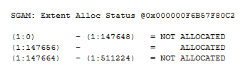
SGAM (Shared Global Allocation Map)
Page 3: SGAM
Tracks if a mixed extent is allocated or not
Mixed extent = 8 pages belong to different objects
All operations need a latch on SGAM page
to know which page is allocated or not

Slide 15

Multiple transactions hit on a datafile
PFS
Page 1
GAM
Page 2
SGAM
Page 3
data pages
PFS 2
Page 8088
data pages
GAM 2
Page 511232
SGAM 2
Page 511233
Tempdb.mdf
https://gohigh.substack.com/p/pfs-gam-sgam-pages

Slide 16
Identify Object Allocation Contention
PAGELATCH_UP, PAGELATCH_EX waits on PFS and (S)GAM pages
How to find them:
2:FileID:1 or 2:FileID:<any PFS or (S)GAM page>
Perfmon counters:
Access Methods::Worktables created/sec
Access Methods::Workfiles created/sec
Number > 200

Slide 17
Resolve Object allocation contention
Multiple Transactions
Transactions are spread across multiple datafiles
Allocation 1
Allocation 2
Allocation 3
Allocation 4
PFS
PFS
PFS
PFS
PFS
GAM
GAM
GAM
GAM
GAM
SGAM
SGAM
SGAM
SGAM
SGAM
data pages
data pages
data pages
data pages
data pages
Allocation 5
Allocation 6
Allocation 7
Allocation 8
PFS 2
PFS 2
PFS 2
PFS 2
PFS 2
data pages
data pages
data pages
data pages
data pages
GAM 2
GAM 2
GAM 2
GAM 2
GAM 2
SGAM 2
SGAM 2
SGAM 2
SGAM 2
SGAM 2
Tempdb.mdf
Tempdb.mdf
Tempdb_1.ndf
Tempdb_2.ndf
Tempdb_3.ndf

Slide 18
Resolve Object allocation contention
Round Robin
between datafiles
between PFS pages starting in SQL Server 2017 CU7
Create 1 data file per logical processor up to 8 logical processors
Additional files in numbers of 4
Create with same size and same autogrowth
Proportionally fills datafiles based on empty space

Slide 19
Resolve Object allocation contention – by SQL Server version
Prior to SQL 2016: Turn ON Trace flags 1117, 1118
SQL 2016 and onwards: Trace Flags are ON by default
SQL 2019: PFS page is updated with a shared latch instead of exclusive latch
SQL 2022: GAM and SGAM pages are updated with a shared latch
Follow best practices across all versions

Slide 20
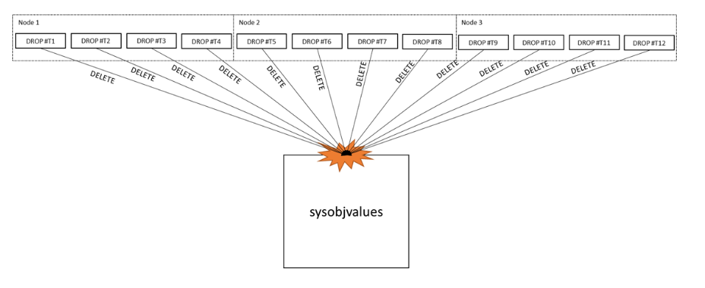
Metadata contention – DDL
In any database, when there are create, alter, drop operations on user objects, they need a latch on system object pages on a datafile.
In tempdb, there are numerous create, alter, drop sessions running concurrently on temporary objects, waiting for a latch on system object pages, causing contention
https://learn.microsoft.com/en-us/archive/blogs/sql_server_team/tempdb-files-and-trace-flags-and-updates-oh-my

Slide 21
Identify Metadata Contention
PAGELATCH_EX, PAGELATCH_UP waits on system catalog tables - such as sysobjvalues and sysschobjs
How to find them 2:FileID:<system page>
Perfmon counters:
SQLStatistics::PageLatch Wait
Temp Tables Creation Rate
Temp Tables Destruction Rate

Slide 22
Resolve Metadata contention
Don’t drop/truncate temp tables
Cache temporary objects:
Don’t alter temp table DDL statements after creation
Create temp objects within SP, trigger, function
Enable Memory-Optimized TempDB Metadata starting SQL 2019
CU2 moves sysallocunits

Slide 23
Temp table cache contention
Contention on cache for Temp table memory objects
Why?
Inefficient usage of Hash tables in cache

Slide 24
Identify/Resolve Temp table cache contention
CMEMTHREAD waits
SOS_CACHESTORE spinlock waits
Open a Microsoft case, needs advanced debugging

Slide 25
DEMO

Slide 26
Summary: Object Allocation Contention
Observe: PFS, GAM, SGAM pages
Wait Type: PAGELATCH_UP, PAGELATCH_SH
Resolution:
Multiple Datafiles
Upgrade to SQL Server Version 2022

Slide 27
Summary: Metadata Contention
Observe: System Object pages
Wait Type: PAGELATCH_EX, PAGELATCH_SH
Resolution:
Don’t drop Temp objects
CACHE Temp objects
Turn ON in-memory TempDB metadata feature in SQL Server Version 2019 and above

Slide 28

Summary: Temp Table Cache Contention
Observe: Huge memory objects in cache
Wait Type: CMEMTHREAD, SOS_CACHESTORE
Resolution:

Slide 29
Why learn about TempDB Contention
Troubleshoot Slowness
Concurrency Management

Slide 30
Q & A!

Slide 31
Resources
TempDB: The Good, The Bad, and The Ugly by Pam Lahoud
https://youtu.be/5jpfy19yl7k?si=vmgf3zqxokurpeo0
OStress utility: https://learn.microsoft.com/en-us/troubleshoot/sql/tools/replay-markup-language-utility
Klaus Aschenbrenner: https://www.sqlservercentral.com/blogs/improved-temp-table-caching-in-sql-server-2014
Pro SQL Server Internals book by Dmitri Korotkevitch

Slide 32
Reach Out For More Questions
Email: haripriya.naidu1@gmail.com
LinkedIn: https://www.linkedin.com/in/haripriya-naidu1215
GitHub: https://github.com/haripriyasb/tempdb
Substack: https://gohigh.substack.com

Slide 33
Thank You!

